Slide 1
Aashish Rijal
Csit first semester
Section-b
roll.no- 02

Slide 2
Welcome to the presentation on network protocols
In this presentation, we will discuss what network protocols are, why they are important, and some example of commonly used network protocols

Slide 3
what are network protocols ?
A network protocol is a set of rules and procedures that govern how data is transmitted over a network.
These protocols ensure that devices on the network can communicate with each other effectively and efficiently.
Network protocols can be divided into different layers, such as the OSI (Open Systems Interconnection) model, which has seven layers.

Slide 4
Why are network protocols important ?
Without network protocols, devices on a network would not be able to communicate with each other.
Network protocols provide a standardized way for devices to communicate, which makes it easier for different devices from different manufacturers to work together.
Network protocols also provide a level of security by ensuring that only authorized devices can access the network and its resources.

Slide 5
Examples of network protocols
TCP/IP (Transmission control protocol/Internet Protocol): The most commonly used network protocol, used for communication over the internet.
HTTP (Hypertext Transfer Protocol): Used for communication between web browser and web server.

Slide 6
Examples of network protocols
FTP (File Transfer Protocol):Used for transferring file between devices on a network.
SMTP (Simple Mail Transfer Protocol):Used for sending mail messages between mail servers.
DNS (Domain Name System):Used for translating domain names into IP addresses.

Slide 7
OSI (Open system Interconnection) layer
It describes seven layers that computers system use to communicate over a network.
It was first standard model for network communication.
Control is passed from one layer to another layer.

Slide 8
Osi layers Divided into 2 groups
Upper layer : Application, Presentation and Session Layer
Lower Layer : Transmission, Network, Data Link, Physical layer
Each layer performs a specific function and communicates with the layer above or below it.

Slide 9
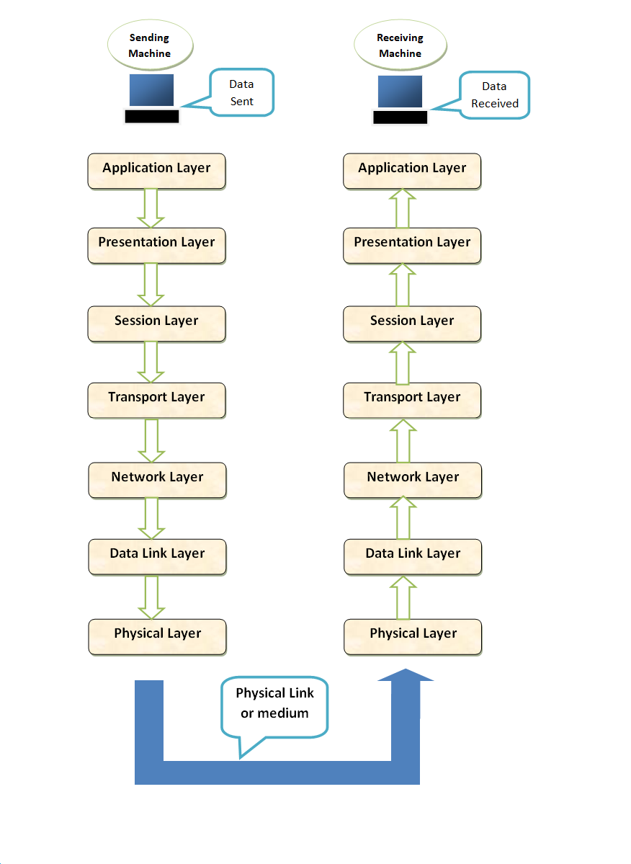

Slide 10
physical layer
This layer is the layer that interact directly with the end user.
It operates at the bit level, it only deals with individual bits of data.
It provides services such as data encoding/decoding, signal transmission, error detection/correction.
Physical layer include some common protocol Ethernet, Wi-Fi and Bluetooth.
The main function of physical layer is to ensure reliable transmission of data over the physical medium.

Slide 11
Data link layer
Providing a reliable and error-free communication channels between different network nodes.
Combines bits into bytes and bytes into frame.
It uses MAC address
Establishing and releasing logical connections between network nodes.

Slide 12
Network layer
It provides logical addressing(Ip) to identify devices on a network.
It determines the optimal path for data transmission between hosts by using routing protocols.
It can breaks large packets into smaller packets for efficient transmission.
It provides error detecting and correction mechanism to ensure data reliability.

Slide 13
Application layer
Move Bits between devices (converts bits into binary form).
It includes protocols such as HTTP, FTP, SMTP etc.
It plays a critical role in enabling communication between different applications and devices.

Slide 14
Transport layer
It specifies the details of handle reliable transfer of data.
It handle end to end error control and flow control, breaking up data into frames and reassembling the frames.
It is responsible for service to service delivery (TCP).
Eg: web browsers, email clients and file transfer programs.

Slide 15
Session layer
It includes specifications for password and authentication and maintaining synchronization between the sender and the receiver.
It ensures that data is delivered to the correct application on the receiving device by using port number to identify different applications.

Slide 16
Presentation layer
The presentation layer is responsible for the formatting and presentation of data.
It provides services data encryption/decryption and data conversion.
It ensures that data send from one system can be understood by the receiving system.
It is closely related to the application layer, both provides end-to-end services.

Slide 17
Application layer
It is completely user oriented layer.
It is responsible for providing network services to application programs
It deals with the services attached to the data.
It contains the protocols used by users like HTTP, protocol for file transfer and electronic mail.

